Slide 1
RDF More Explored
RDFS

Slide 2
Relational Database Schema?
Neutral

Slide 3
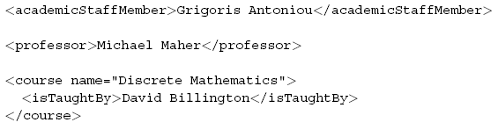


Slide 4


Slide 5
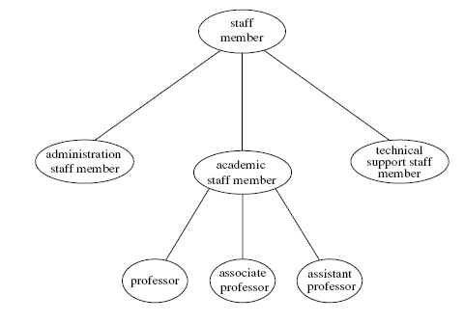

Slide 6
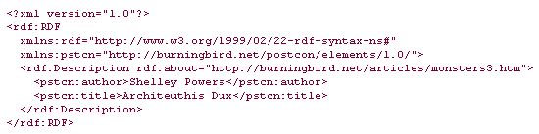
Every resource within an RDF document, such as the article has a common ancestor class: rdfs:Resource.

Slide 7
The RDF fragment also uses rdfs:Class.
All new resource types are identified by an rdfs:Class statement, including the rdfs:Resource element itself.
The Class element is very similar to its same-name counterpart in object-oriented development—a unique object that can be described and can have associated behaviors.

Slide 8
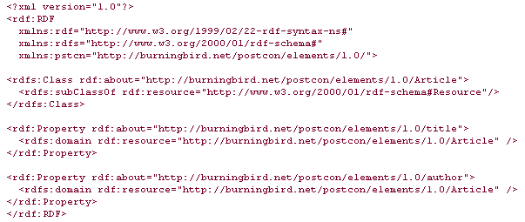
RDF Schema for Article

Slide 9
The RDF specification's purpose is purely to define resources and associated facts, and then provide a way to allow these resource/fact mappings to interact.
This is accomplished through capturing statements about the resource, with each statement consisting of a specific property such as title and author for the Article resource.
Statements about each resource are captured as individual properties

Slide 10
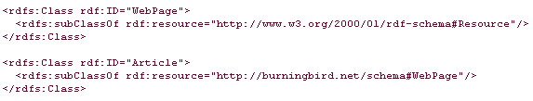
Article could also be a subclass of another class such as WebPage, which is, in turn, a subclass of Resource, as demonstrated in the following RDF/XML snippet:

Slide 11
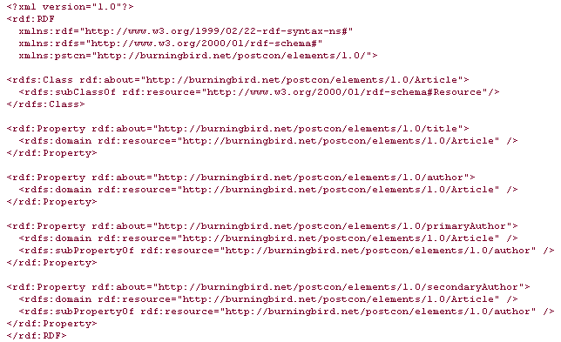
RDF Schema example of property refinement

Slide 12
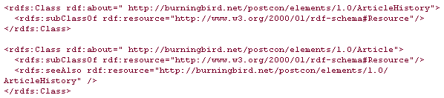
The rdfs:seeAlso property is used to identify another resource that contains additional information about the resource being described.
relationship between an article and a document maintaining the history of the article,

Slide 13
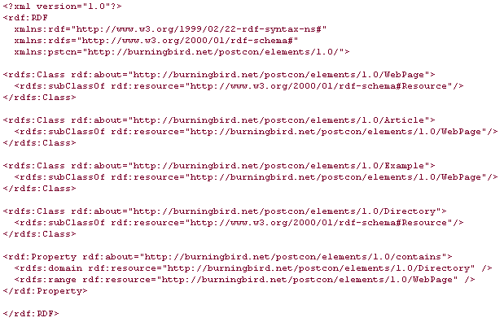
The web resources can be articles or examples; to allow both in the new contains range, a master class, WebPage, is created; it is then refined through the use of rdfs:subClassOf to create Article and Example classes. The master class is used as the value for the rdfs:range property of the contains class.

Slide 14

Range Restrictions
Consider the following statement
Schema may be defined as on the next slide

Slide 15
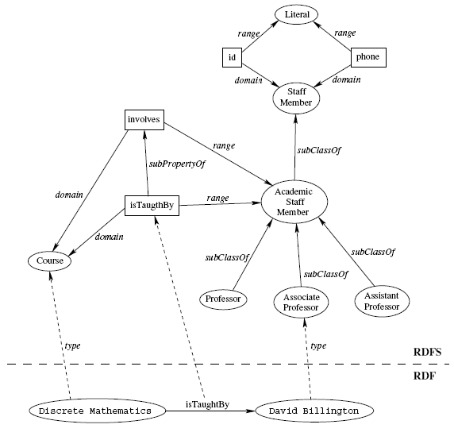

Slide 16
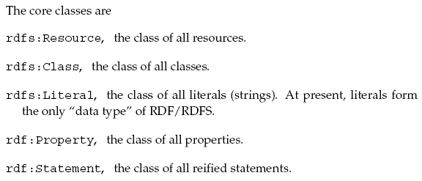
RDF(S) Core Classes

Slide 17
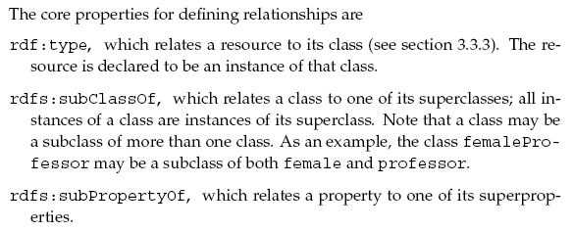

Slide 18
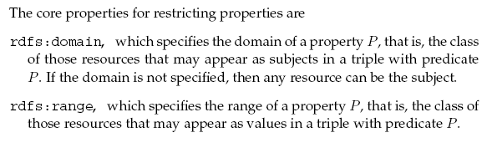


Slide 19
Reading Recommended Chapter 3 of “Semantic Web Primer”
Try to solve all the problem of the exercise at the end of chapter 3
Read other stuff as recommended already and placed in the folder.

